Slide 1
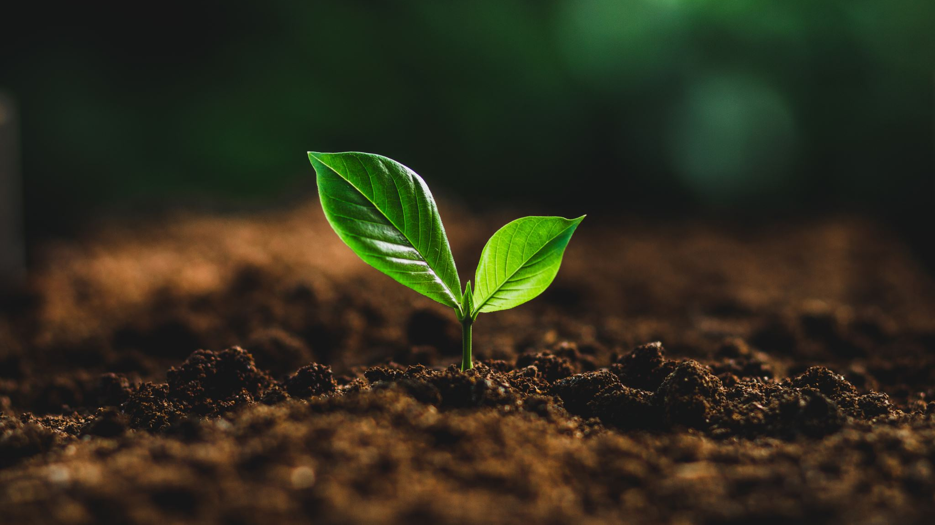
An IoT-Enabled AI System for Real-Time Crop Prediction Using Soil and Weather Data

Slide 2
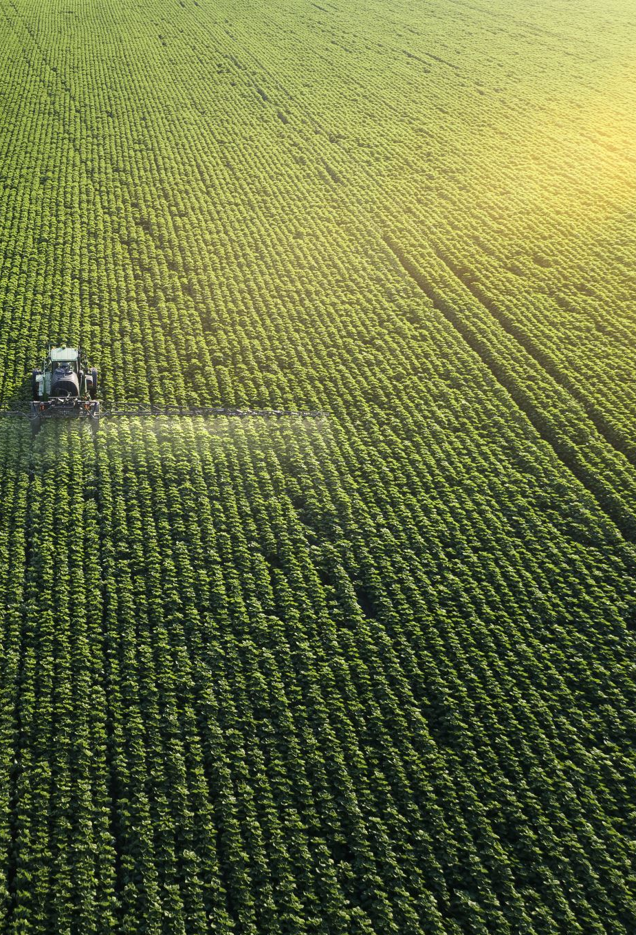
Why is this research necessary?
Agriculture contributes about 11.5% to Bangladesh’s GDP. Agriculture makes up 11.5% of Bangladesh’s GDP and about 47% of total economic output.
Bangladesh can become economically specialized in agriculture and the biggest food provider in the future, but technological analysis and automation are essential for that.
Crop recommendation and sustainability checking can reduce production cost, fertilizer misuse, and many other issues.

Slide 3
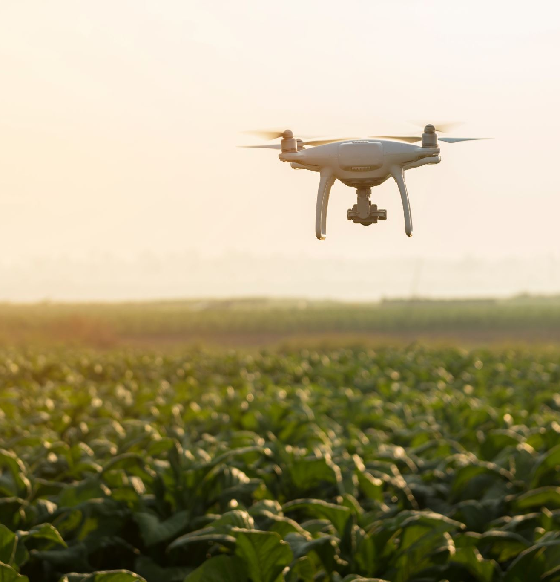
Identifying issues
There is no real-time crop monitoring technology available in the field in Bangladesh.
Farmers/agriculture practitioners blindly choose crops without soil testing.
Traditional crop choosing and farming lead to fertilizer overuse.
Countries like China, Thailand, Vietnam, and others are getting good benefits with IoT in agriculture and reducing overall crop production costs, and even early monitoring helps them to harvest more crops than average.
Manual monitoring is inefficient and often prone to errors, making it difficult to manage crops effectively.

Slide 4
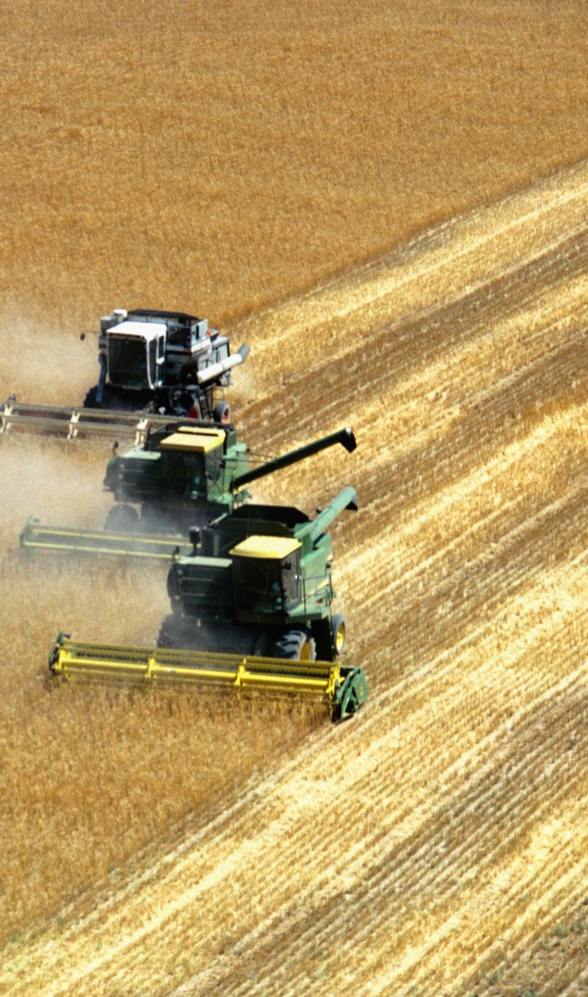
Objective
This study aims to develop an IoT-based crop prediction system that utilizes real-time data on soil nutrients(N, P, K), pH, and weather conditions. The system employs machine learning and deep learning techniques to recommend suitable crops based on local environmental factors. The implementation focuses on deploying the best-performing models on an edge device for real-time predictions, ensuring accuracy, efficiency, and accessibility for farmers and agricultural stakeholders.

Slide 5
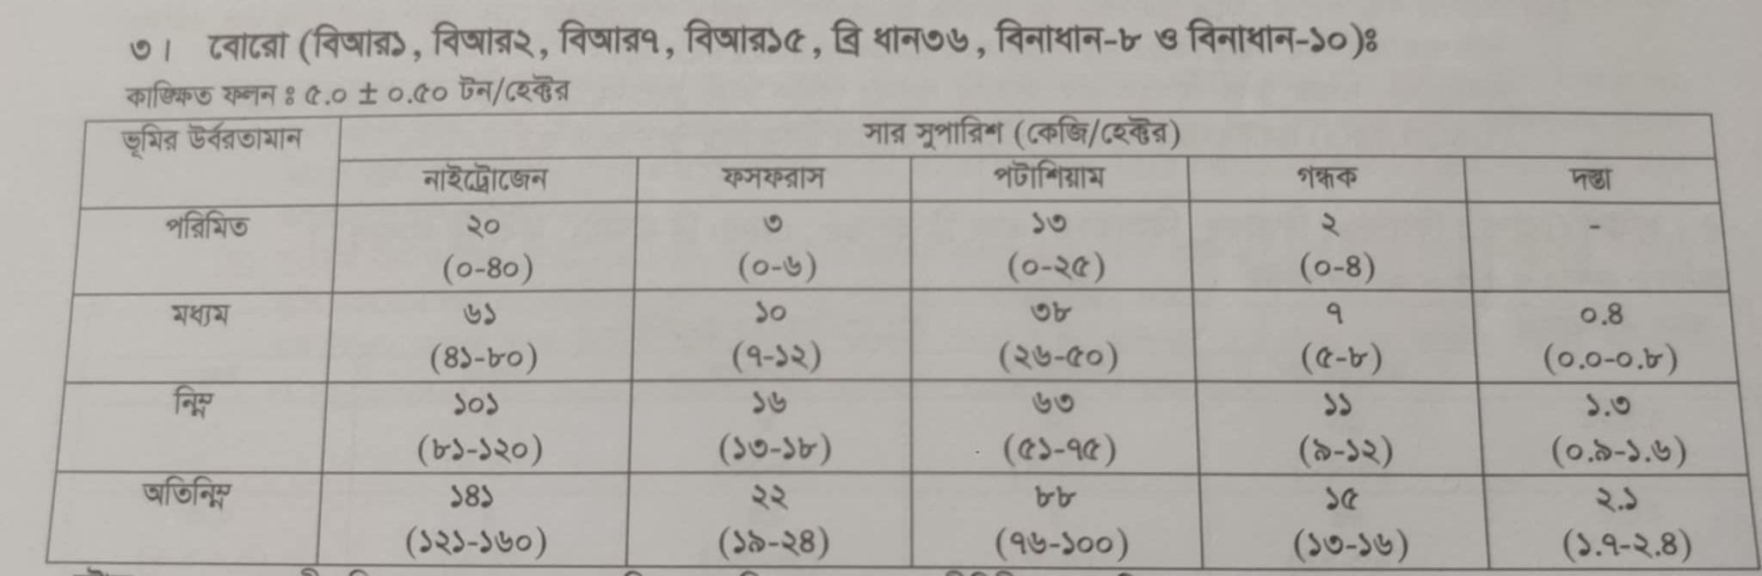
Methodology ( Data Collection )
Initially, data was collected from the book of the SRDI(Soil Research and Development Institute).

Slide 6
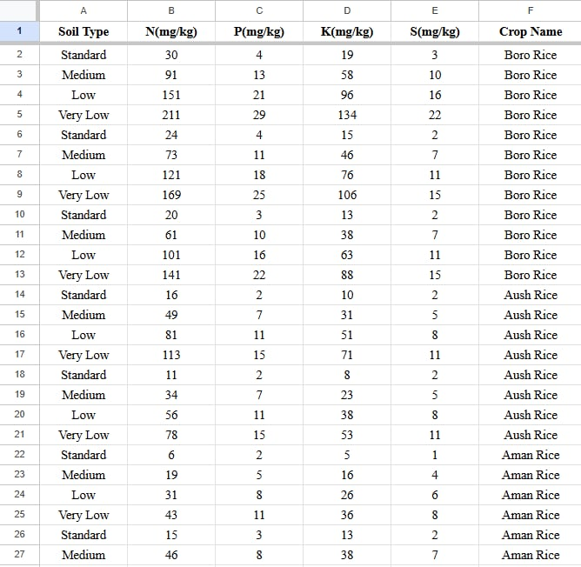
Methodology ( Data Collection )
The data was manually loaded into an Excel sheet as raw data.

Slide 7
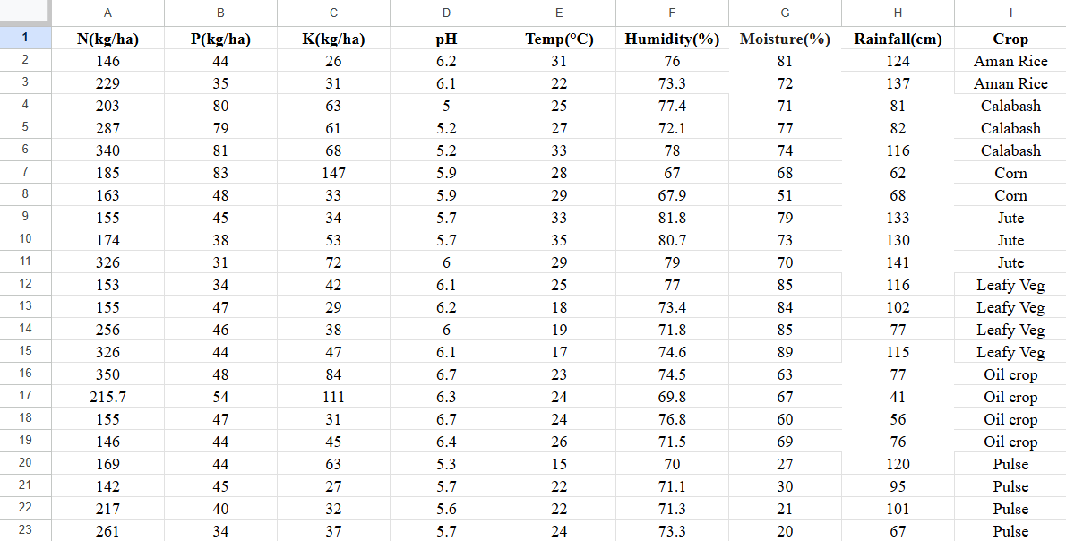
Data process and weather data integration
The Bangladesh Agro-Meteorological Information Service(BAMIS) collected and integrated crop-wise weather data.

Slide 8
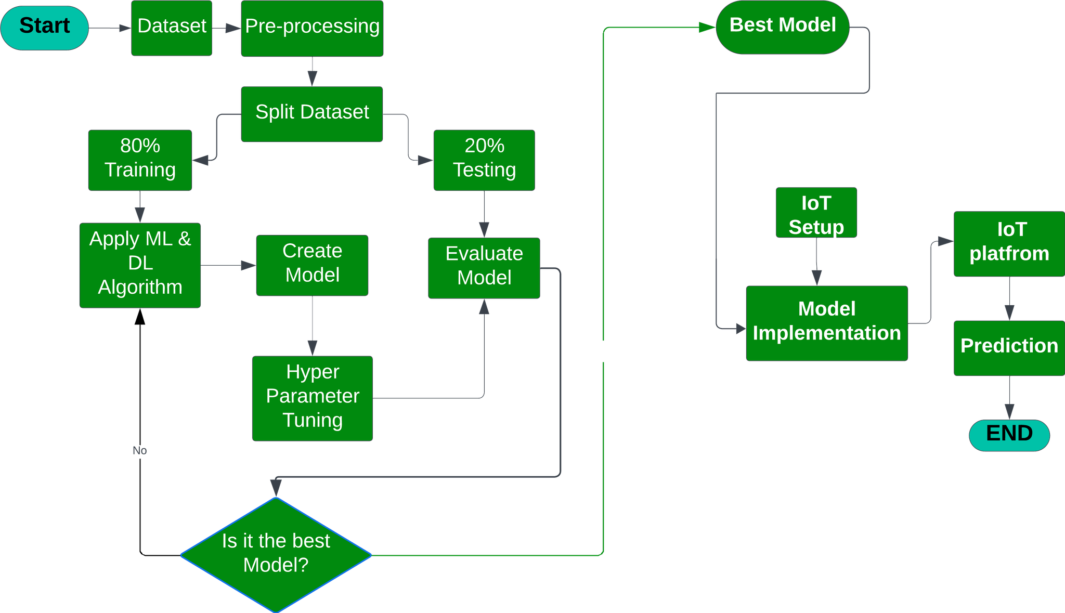
Machine and deep learning
After the dataset was ready, we input the data into the ML & DL model, where the input features were N, P, K, pH, temp, humidity, moisture, and rainfall, and the output/predictive feature was Crop.

Slide 9
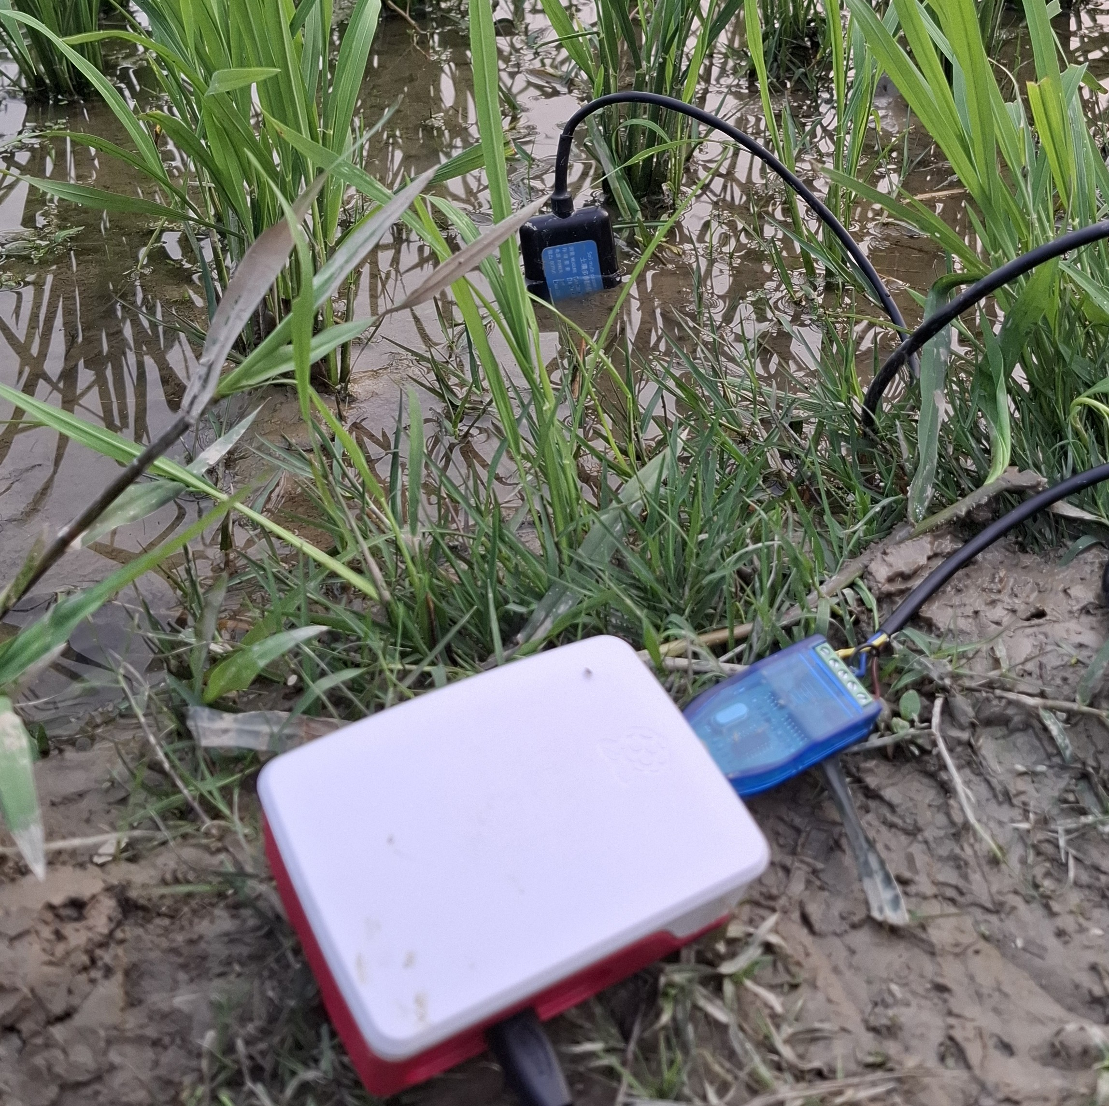
Edge Device/IoT Setup
Raspberry Pi 5B
7 in 1 Agriculture soil sensor
Other electronics
Battery(optional)

Slide 10
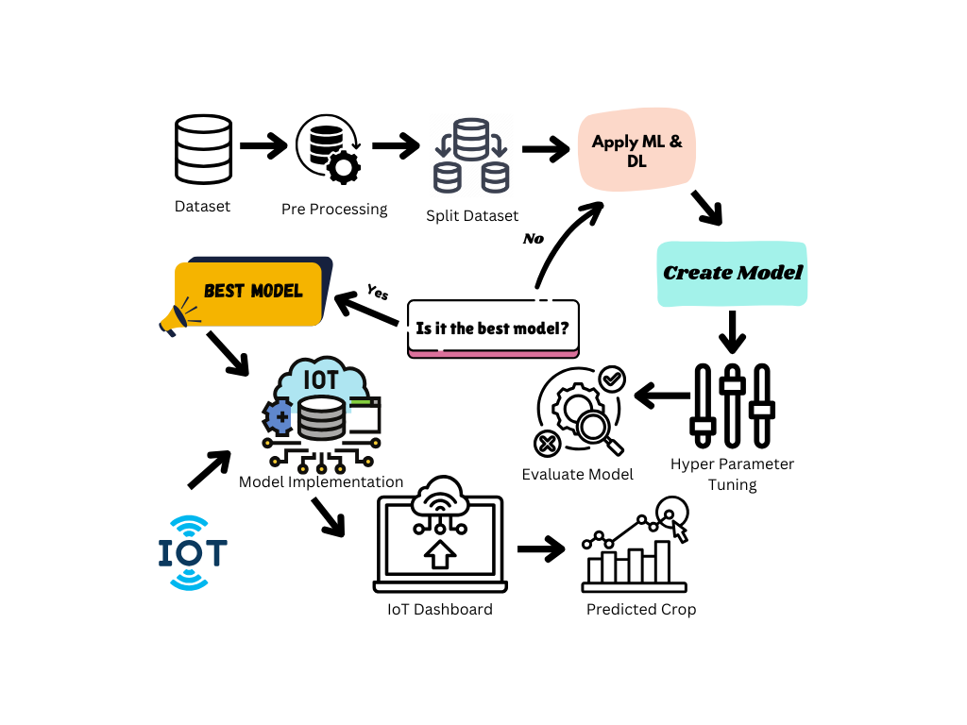
System Architecture

Slide 11
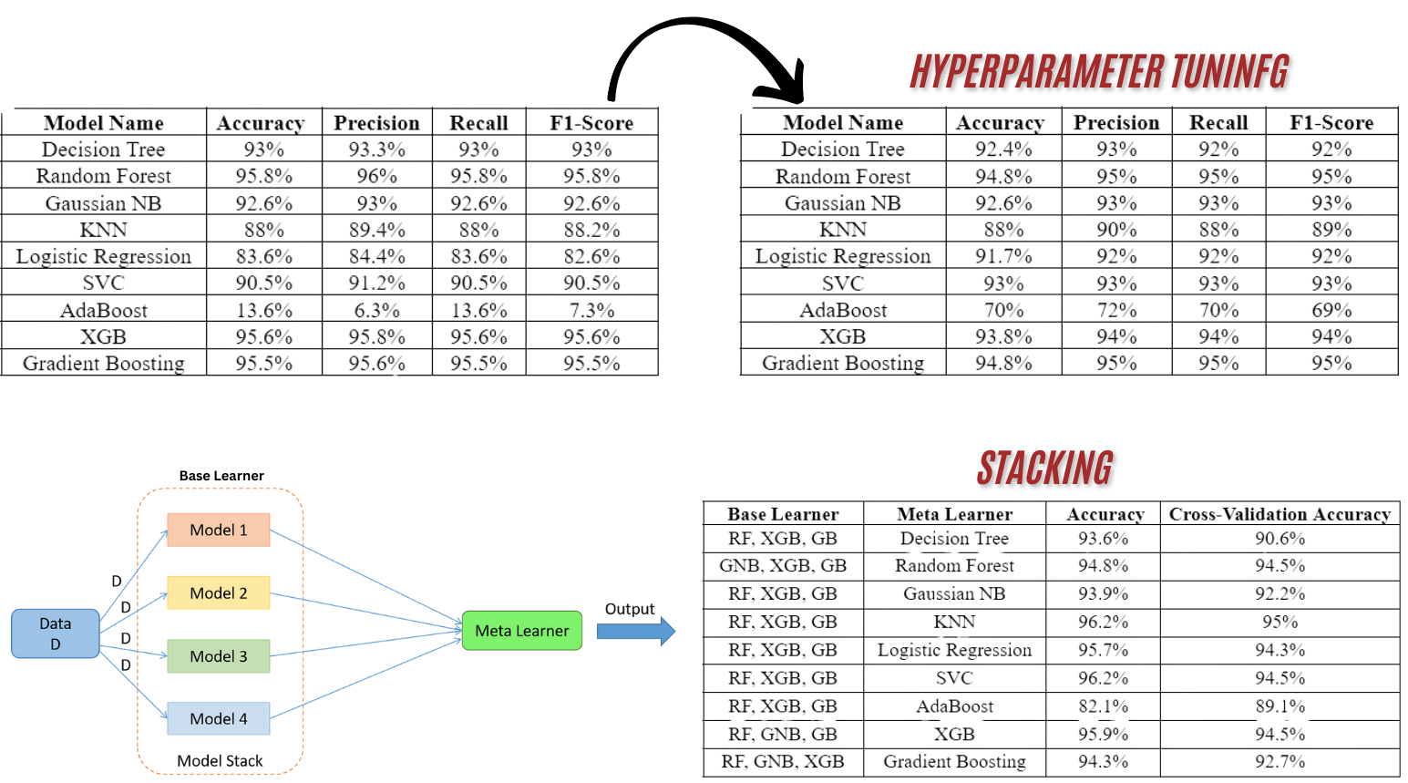
Result of Machine Learning & Deep learning
To get the best performance from the ML,DL model, we have tested with many models, done hyperparameter tuning, and finally got the best model with outstanding performance and generalization for usability.

Slide 12
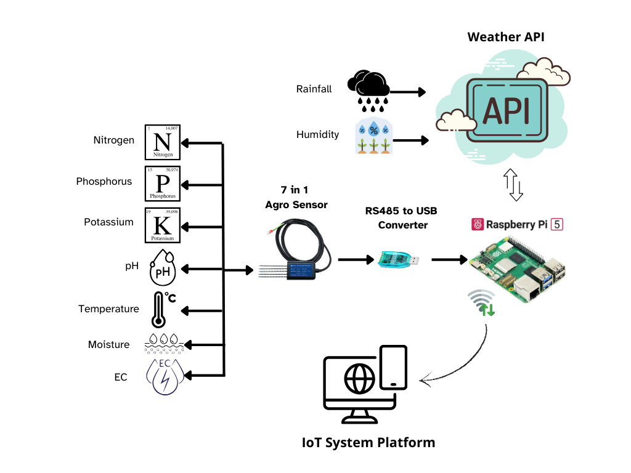
Real-time sensor-driven data and weather API based prediction
After implementing the best model into the edge device, we collected the data from the sensor and the weather API (location-based), which directly goes to the model, and the model gives us the best sustainable crop according to the exact location and soil.

Slide 13
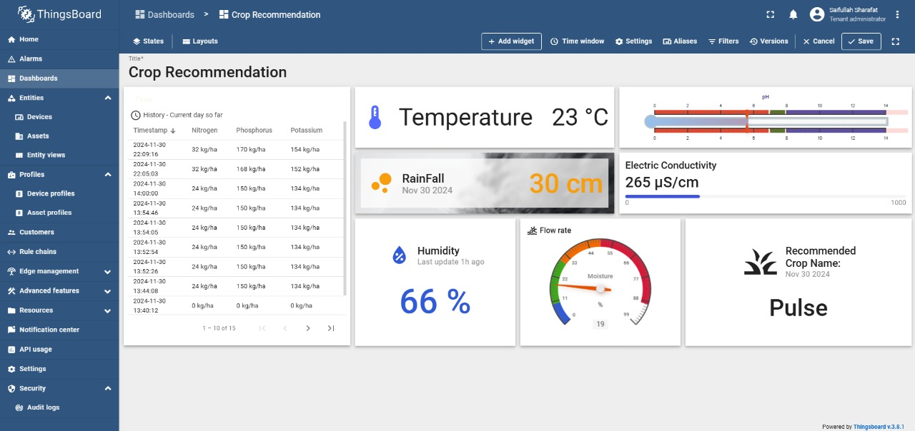
Web Interface & app monitoring (Real-time monitoring)
Things board IoT platform has been used for remotely monitoring, and they also provide app monitoring, alert, and different IoT protocols like MQTT, HTTP, and HTTPS.

Slide 14
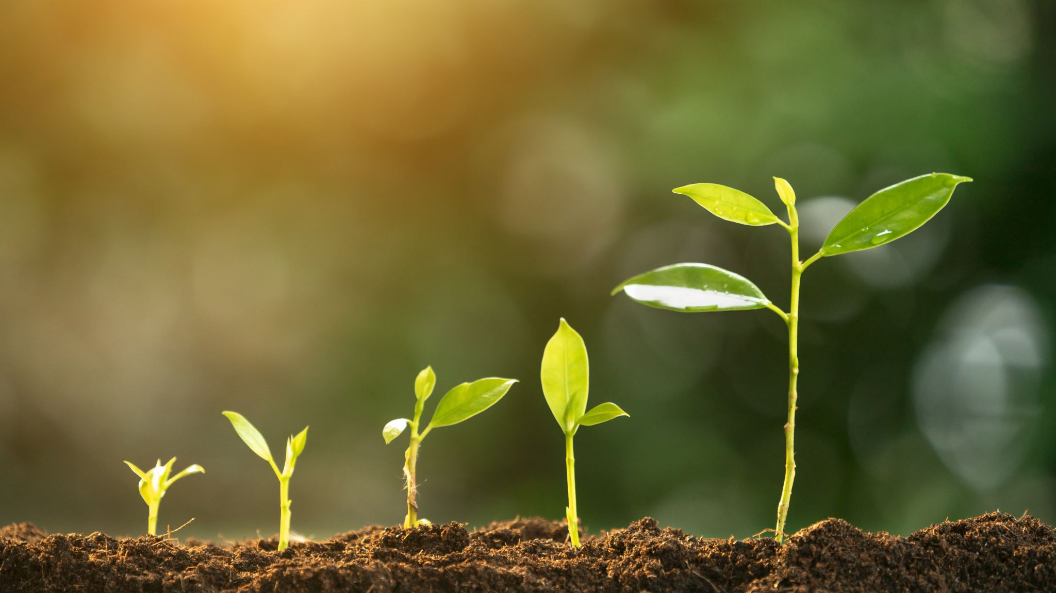
Thank you for being with us

